Slide 1
Katana Capital Limited
ASX CODE KAT
AGM presentation
NOVEMBER 2017
Performance. Process. People. Passion.

Slide 2
Disclaimer
The information contained in this presentation is provided to each recipient on the following basis:
this presentation has been produced by Katana Asset Management (KAM). This presentation does not purport to contain any information that the recipient may require to evaluate KAM’s performance
KAM is the holder of Australian Financial Services License No: 288412.
none of KAM, Katana Capital Ltd, their respective directors, officers, employees advisers or representatives (collectively the representatives of the company/license) make any representation or warranty, express or implied, as to the accuracy, reliability or completeness of the information contained in this presentation and nothing contained in this presentation is, or shall be relied upon as a promise of representation, whether as to the past or the future.
except insofar as liability under any law cannot be excluded, the Beneficiaries shall have no liability arising in respect of the information contained in or not contained in this presentation.
statements in this presentation are made as of the date of this presentation unless otherwise stated.
this is a general presentation only and it is not a recommendation and there is no consideration of the personal circumstances of any person;
under no circumstances should this be taken as financial advice.

Slide 3
Overview
Key Metrics
Katana Profile – Personnel
Investment Approach
Fund Performance & Opportunity

Slide 4
Key Metrics
FY17 Performance vs Benchmark
  Gross Investment Return 6.23% vs Benchmark (All Ords Index) +8.54%
In Context - 11 Year Performance vs Benchmark
  Outperformed the index benchmark in 8 out of 11 years
Dividends
  Paid 4x quarterly dividends totalling 2c per share (Average ~70% franked)
  Dividend yield below prior years and expected to increase in FY18
FY18 YTD Strong Start
  YTD performance +11.19% vs Benchmark 3.68% (as at 31st October 2017)

Slide 5
Katana Profile – Personnel
Investment Staff
Manager – Skills and Experience
  Combined direct investment experience of >110 years
  Covers 4 stock market cycles
  Professional Qualifications - economics, business, accounting, investment analysis, mining, geology
  Diverse Backgrounds – domestic, international
  Results Focused
  Strong Processes - rigorous decision-making.
  Media Recognition - regular contributions to all forms of media
  Aligned Interests - managers personally own ~22% of FUM

Slide 6
Katana Profile - Personnel
Support Staff & Service Providers
General Katana Asset Management | Address | AMP Building, Level 16, 140 St Georges Terrace, Perth
 | Administration | Christine Fernandez Stephanie Taverniti Ashleigh Smith
 | Compliance | Jacqui Stewart - GRC Essentials
 | Custodian | JP Morgan and Link Markets
 | Banker | JP Morgan
Katana Capital Limited | Auditors | Ernst & Young
 | Share Registry | Computershare
 | Legal Advisors | Steinepreis Paganin
 | Board of Directors | Dalton Gooding (Chairman) Peter Wallace Giuliano Sala Tenna
 | Company Secretary | Gabriel Chiappini

Slide 7
Investment Approach
Philosophy
Think independently but act in unison with the market, by combining the best precepts of the
5 key investment disciplines:
Value Investing
Fundamental Analysis
Growth Investing
Technical Analysis
Market Experience and Observation
Overriding pre-occupation with capital preservation
Comfortable to remain weighted in cash for extended periods
Emphasis on flexibility within a strong overlying framework of accountability & risk management
Companies are imperfect; our lot is to choose the ‘less imperfect’ by clearly prioritising our
investment criteria

Slide 8
Investment Approach
Fund Parameters
Portfolio Overview
Long only
ASX listed securities
Benchmark ‘Unaware’ – i.e. flexibility to maximise returns without constraints on market capitalisation, sector or theme.
By removing restrictions on size, sector and weightings, we enable each investment to be assessed on its merit.
Top Down Macro Overlay with
Bottom Up Stock Analysis
Economic cycle (timing) decisions
Asset allocation - preparedness to move to, and maintain a cash position
Sector allocation – portfolio based on prospectivity not sector weighting
Stock selection and allocation
Portfolio Parameters
45-60 individual stock positions
Average position size 1%–5%, with a pre-disposition towards holding a greater number of smaller positions
Mandated maximum position sizes based upon market capitalization and liquidity
Cash Position mandate range is 0 – 80%; historically 15%-35%.
Generally towards the upper end of this range and has been as high as 50% of funds under management.
Achieving high returns with a high cash balance reduces risk through the cycle.
Significant value added with stock positions outside ASX100
Thematic exposure achieved through ASX100, but additional alpha derived through detailed bottom-up analysis of ex-100
No gearing or shorting applied in the portfolio
“Performance. Process. People. Passion.”

Slide 9
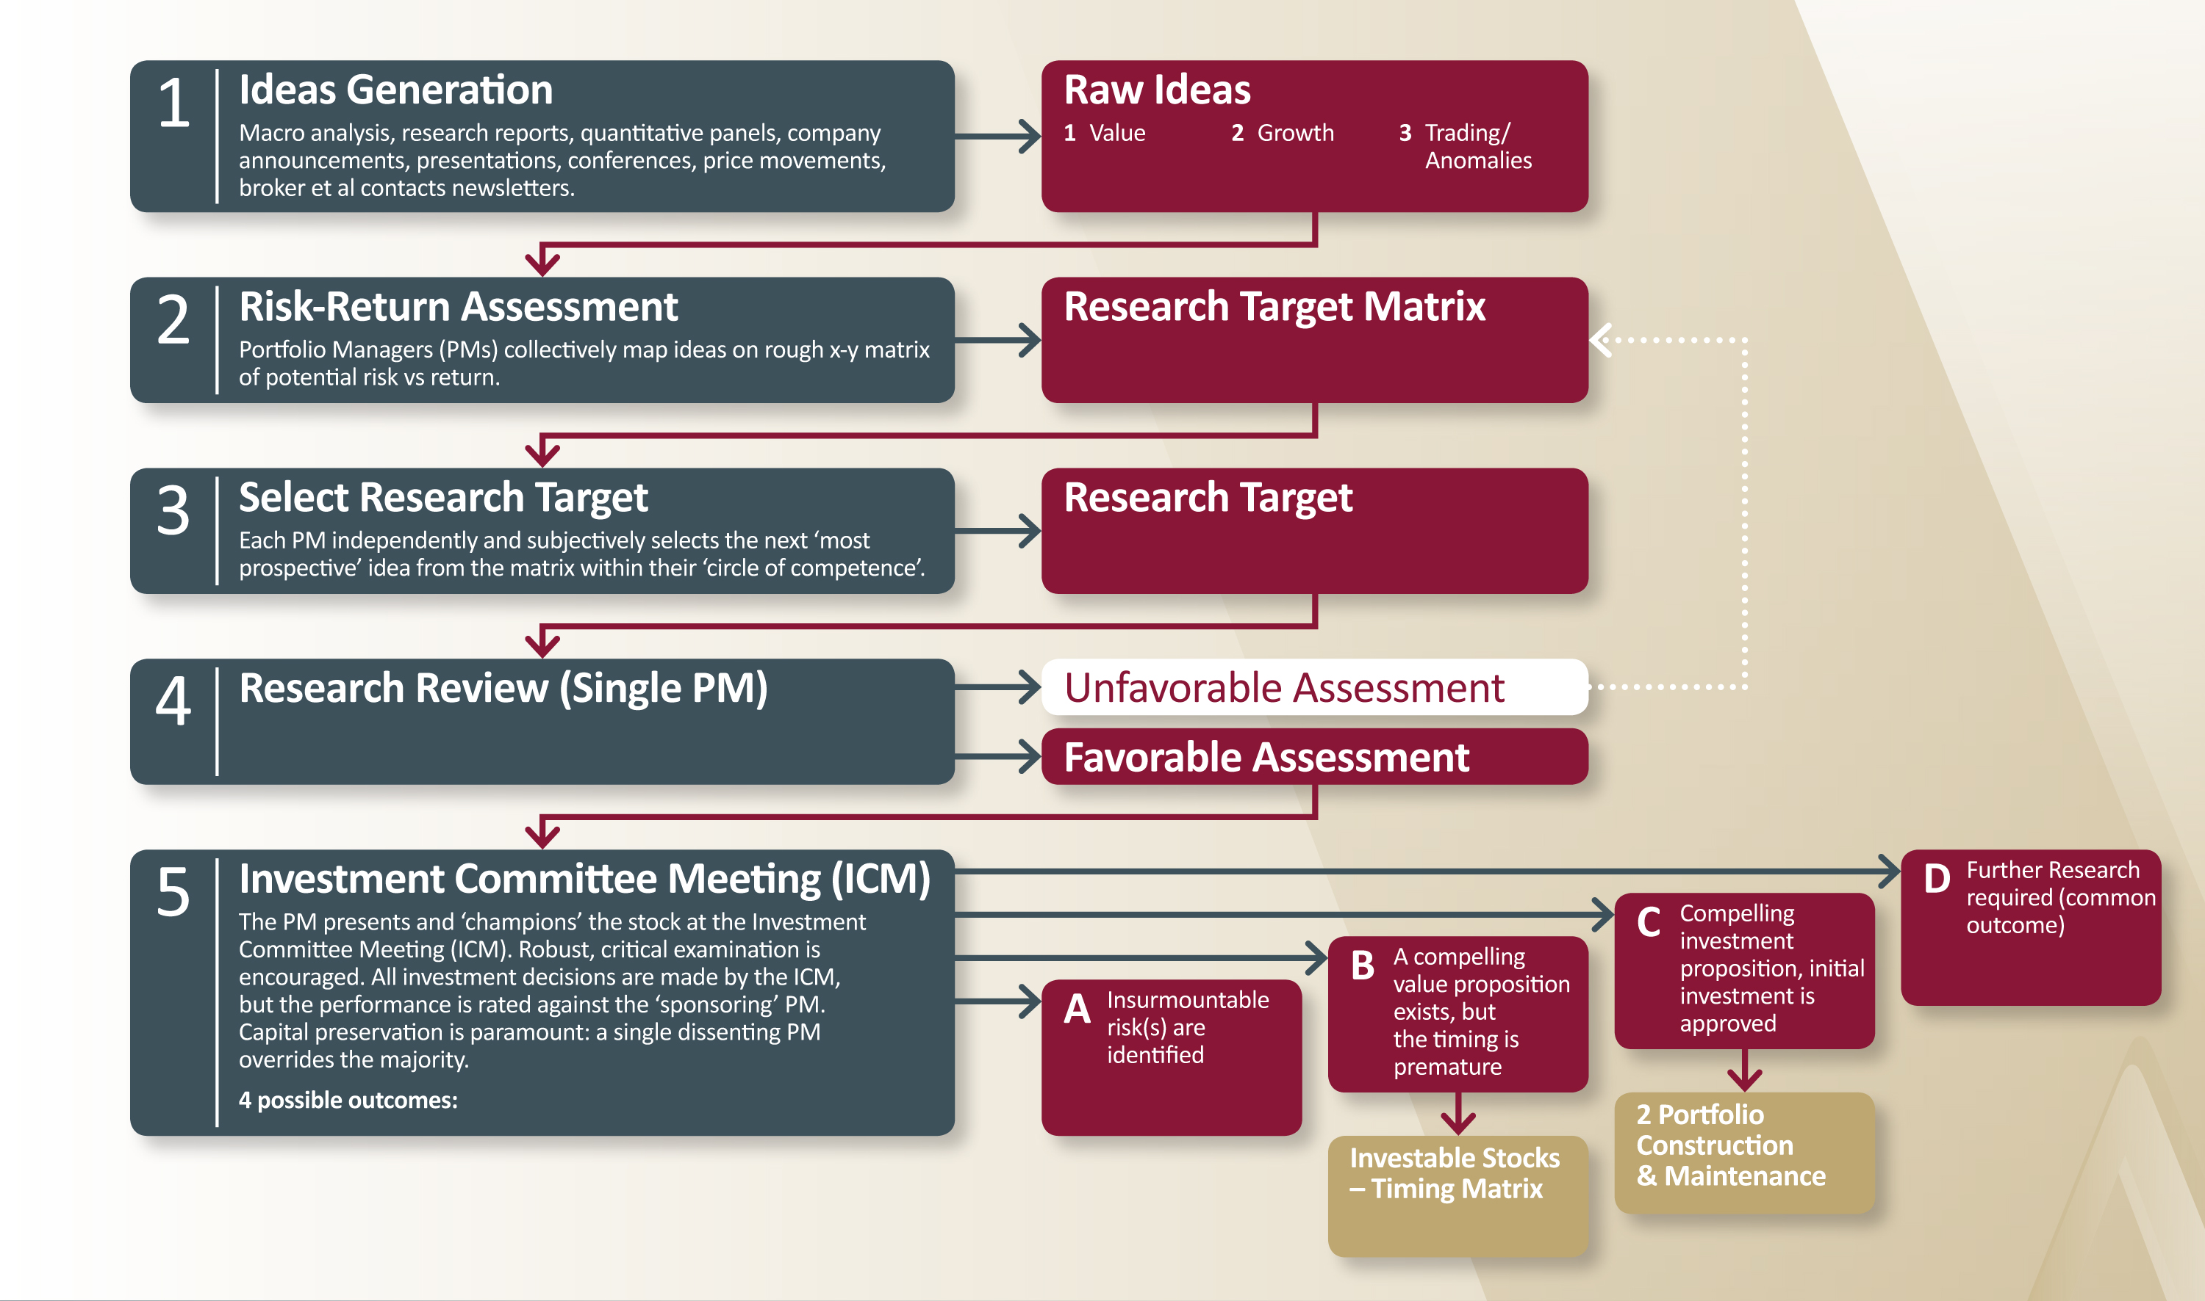
Investment Approach
Decision Process

Slide 10
Investment Approach
Typical portfolio – “All-Opportunity”
Historical Characteristics:
~ 5 of the top 10 portfolio holdings in ASX50
2-3 of the top 10 portfolio holdings in ASX100
2-3 of the top 10 portfolio holdings in ASX300
1-2 of the top 10 portfolio holdings ex ASX300
Blue chip companies form the largest holdings, providing safety and liquidity
Additional value added through emerging/high growth stocks; overall a good blend of safety + performance
Top 10 companies regularly make up ~ 20 - 35% of portfolio and remaining holdings usually ~ 30 - 40% of Portfolio
Employ a larger number of smaller positions to mitigate risk whilst still being high conviction.
Ordinarily 45 - 60 companies
Encompasses stocks in the accumulation or selling phases as well as trading positions
High ‘through-the-cycle’ balance of Cash
Cash through the cycle is typically within the 15 - 35% band.
A high cash balance provides a lower risk profile over time and a buffet to market volatility.
Top 10 Investments (KAEF) Percentage of Portfolio Valuation as at 31/10/2017
MINERAL RESOURCES LTD | 5.6%
PIONEER CREDIT LTD | 3.9%
CHALLENGER LTD | 3.5%
SANTOS LTD | 3.4%
JANUS HENDERSON GROUP LTD | 2.8%
AMA GROUP LTD | 2.6%
BT INVESTMENT MANAGEMENT LTD | 2.6%
FAIRFAX MEDIA LTD | 2.5%
INDEPENDENCE GROUP NL | 2.4%
INGENIA COMMUNITIES GROUP | 2.2%
Top 10 Equity Investments | 31.4%
Remaining Equities | 44.2%
Cash and Equivalents | 24.4%
Total | 100.0%
Source: KAT
*For most recent Katana Capital Top10 and NTA, please refer to the Katana website.

Slide 11
Fund Performance and Opportunity
Investment Returns
Ongoing Out-Performance Since Inception
Inception date Katana Capital January 2006. Returns quoted are gross investment returns for the fund.
Past performance is not necessarily indicative of future performance.
Source: Katana Asset Management Ltd; IRESS

Slide 12
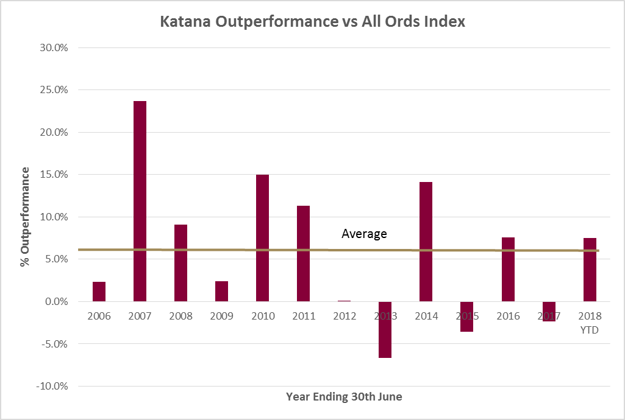
Fund Performance and Opportunity
Investment Returns
Consistent
and Strong
Out-Performance
Since inception, KAEF has out-performed the
All Ords Index by 6.19% per annum on a gross basis.
Inception date Katana Capital January 2006. Returns quoted are gross investment returns for the fund.
Past performance is not necessarily indicative of future performance.
Source: Katana Asset Management Ltd; IRESS

Slide 13
Fund Performance and Opportunity
Outlook
Macro Environment
Low interest rates persist and the path to normalization continues to be pushed out
Global synchronized growth amongst the best on record
Valuations in the US are now well ahead of long term averages
(~2 Std deviations above on a Shiller PE / CAPE Ratio)
China growth ahead of expectations
Australian Landscape
Green shoots are emerging in traditional mining plus new drivers in LNG and EV minerals
East coast is on the verge of an infrastructure boom
Tourism, education and immigration likely to continue to drive opportunities
Property post peak
Political landscape creating uncertainty; not driving growth

Slide 14
Fund Performance and Opportunity
Dividends
Dividend History
Paid dividends every year since listing
Quarterly dividends provide regular cash flow to yield conscious investors
Dividend Reinvestment Plan - company purchases shares on market so no dilution
Future Dividends
Subject to market conditions, dividends are likely to increase in the coming FY

Slide 15
Fund Performance and Opportunity
Opportunity
Discount to NTA
  15% Discount to NTA
  Working to narrow this gap (Buyback, DRP buyback et al)
2 New Portfolio Managers Fully Contributing
  Invested substantial time and cost into team
Historical Performance following Under-performance
  Often, the time to invest with a manager with a long term track record is after a period of under-performance, remembering of course that past performance is no guarantee of future returns

Slide 16
If you would like a more information
Please email enquiries@katanaasset.com
Thankyou
Performance. Process. People. Passion.

